Slide 1


MSCI Index calculation methodology
Version: August 2020

Slide 2
summary
Two ways to calculate the MSCI Price Index will be introduced, accompanying with the corresponding formulas and terms. In fact, most definitions are easy to understand, the true obstacles are the countless details and special cases.
The MSCI Daily Total Return (DTR in short) index methodology will also be discussed. It shares something the same with the MSCI Price Index

Slide 3
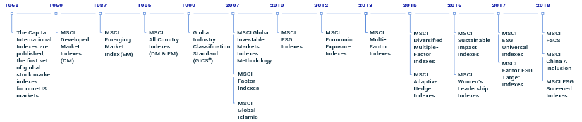
content
Introduction
MSCI Price Index Methodology (Including two ways of calculation)
MSCI Daily Total Return (DTR) Index Methodology
Appendix

Slide 4
Introduction
This methodology book (Version: August, 2020) describes MSCI’s general Index calculation methodology for the MSCI Equity Indexes.
MSCI provides two ways of calculating MSCI Equity Indexes:
The Price Adjustment Factor (PAF)
The Index Divisors
These policies and guidelines affect all securities across the MSCI Equity Indexes and products. Unless otherwise stated the policies and guidelines apply therefore to all securities in the MSCI Equity universe.

Slide 5
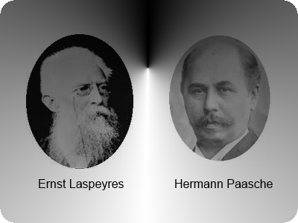
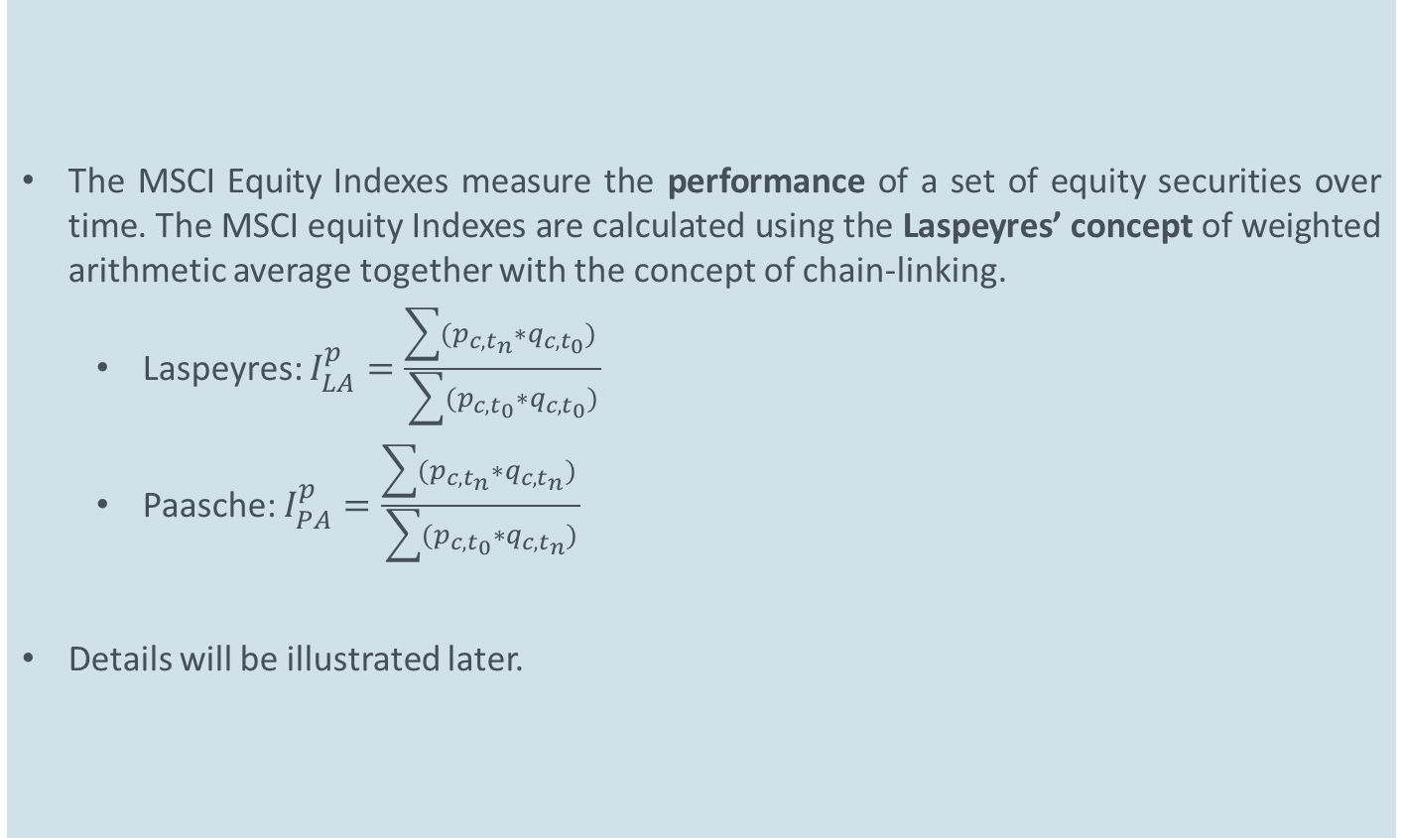
Introduction
The MSCI Equity Indexes measure the performance of a set of equity securities over time. The MSCI equity Indexes are calculated using the Laspeyres’ concept of weighted arithmetic average together with the concept of chain-linking.
Laspeyres: $I_{LA}^{p}=\frac{\sum{(p_{c,t_{n}}∗q_{c,t_{0}}) }}{\sum{(p_{c,t_{0}}∗q_{c,t_{0}})}}$
Paasche: $I_{PA}^{p}=\frac{\sum{(p_{c,t_{n}}∗q_{c,t_{n}}) }}{\sum{(p_{c,t_{0}}∗q_{c,t_{n}})}}$
Details will be illustrated later.
Notes:
最著名的两种算法为拉斯拜尔指数（因德国经济学家拉斯拜尔（Étienne Laspeyres）得名，简称拉氏指数）和帕舍指数（因德国经济学家帕舍（Hermann Paasche）得名，简称帕氏指数）
其中 I 为两个区间的价格水平相对指数； t0为基期，也就是设为运算基准的第一期；tn为当期，也就是计算指数的当下这一时期。
即，拉氏保持基期消费品数量不变而计算价格变动，而帕氏算法则保持当期消费品数量不变而计算价格变动。拉氏指数忽略了价格上涨后，消费者对基期消费组合的自然调整，因此可能会高估通胀水平；同理，帕氏指数以当期消费组合回溯基期并不合理，因而可能会低估通胀水平。

Slide 6
Introduction
While the local currency series of regional indexes cannot be replicated in the real world, it represents the theoretical performance of an index without any impact from foreign exchange fluctuations – a continuously hedged portfolio.

Slide 7
MSCI Price Index Methodology
Price indexes measure the market prices performance for a selection of securities. They are calculated daily and, for some of them, on a real time basis. Each index captures the market capitalization weighted return of all constituents included in the index.
As a general principle, today’s index level is obtained by applying the change in the market performance to the previous period index level. See the formula in next slide.

Slide 8
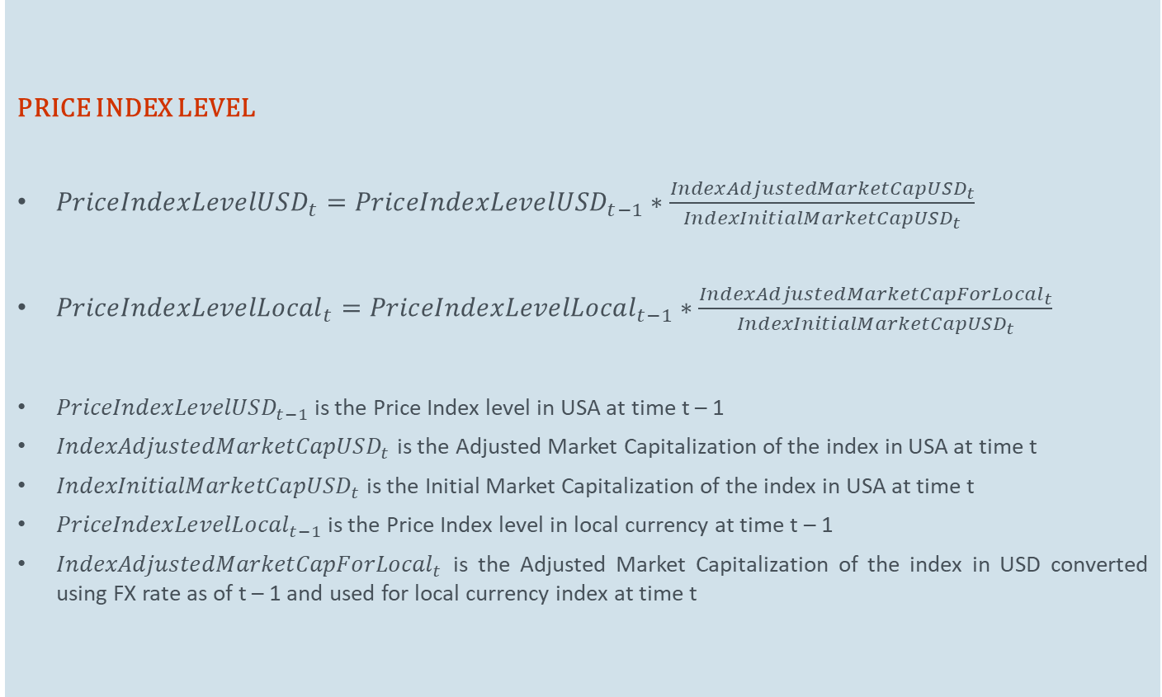
MSCI Price Index Methodology
PRICE INDEX LEVEL
${PriceIndexLevelUSD}_{t}={PriceIndexLevelUSD}_{t−1}∗\frac{{IndexAdjustedMarketCapUSD}_{t}}{{IndexInitialMarketCapUSD}_{t}}$
${PriceIndexLevelLocal}_{t}={PriceIndexLevelLocal}_{t−1}∗\frac{{IndexAdjustedMarketCapForLocal}_{t}}{{IndexInitialMarketCapUSD}_{t}}$
${PriceIndexLevelUSD}_{t−1}$ is the Price Index level in USA at time t – 1
${IndexAdjustedMarketCapUSD}_{t}$ is the Adjusted Market Capitalization of the index in USA at time t
${IndexInitialMarketCapUSD}_{t}$ is the Initial Market Capitalization of the index in USA at time t
${PriceIndexLevelLocal}_{t−1}$ is the Price Index level in local currency at time t – 1
${IndexAdjustedMarketCapForLocal}_{t}$ is the Adjusted Market Capitalization of the index in USD converted using FX rate as of t – 1 and used for local currency index at time t

Slide 9
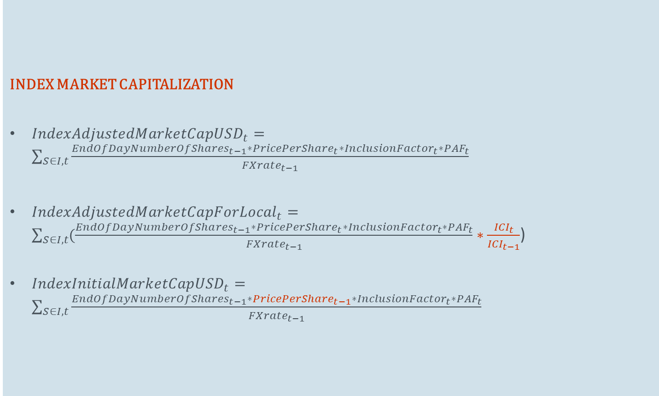
MSCI Price Index Methodology
INDEX MARKET CAPITALIZATION
${IndexAdjustedMarketCapUSD}_{t}=\sum_{S∈I, t}{\frac{{EndOfDayNumberOfShares}_{t−1}∗{PricePerShare}_{t}∗{InclusionFactor}_{t}∗{PAF}_{t}}{{FXrate}_{t−1}}}$
${IndexAdjustedMarketCapForLocal}_{t}=\sum_{S∈I, t}{(\frac{{EndOfDayNumberOfShares}_{t−1}∗{PricePerShare}_{t}∗{InclusionFactor}_{t}∗{PAF}_{t}}{{FXrate}_{t−1}}}∗\frac{{ICI}_{t}}{{ICI}_{t−1}}$)
${IndexInitialMarketCapUSD}_{t}=\sum_{S∈I, t}{\frac{{EndOfDayNumberOfShares}_{t−1}∗{PricePerShare}_{t−1}∗{InclusionFactor}_{t}∗{PAF}_{t}}{{FXrate}_{t−1}}}$

Slide 10
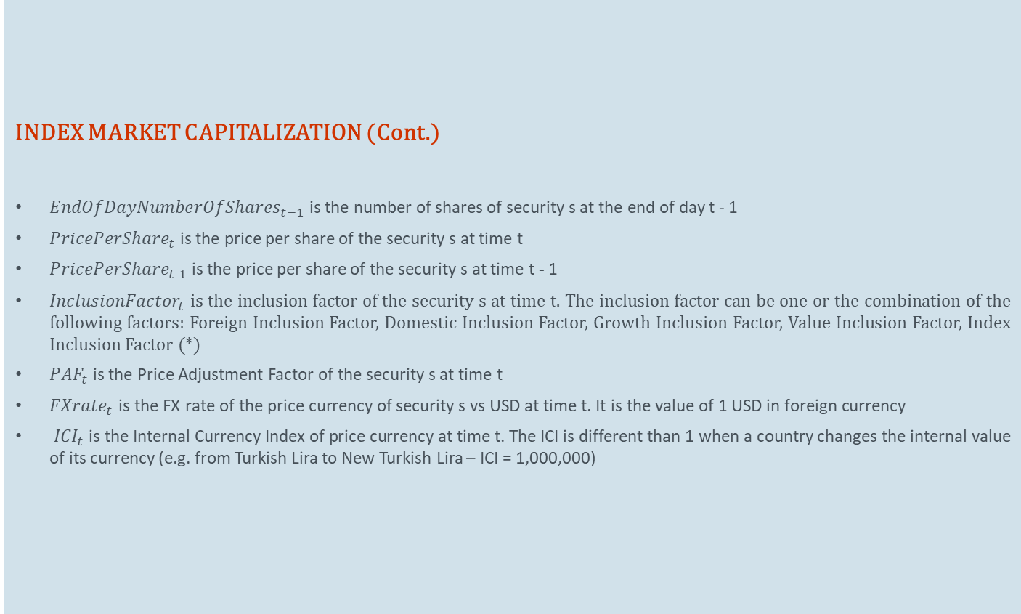
MSCI Price Index Methodology
INDEX MARKET CAPITALIZATION (Cont.)
${EndOfDayNumberOfShares}_{t−1}$ is the number of shares of security s at the end of day t - 1
${PricePerShare}_{t}$ is the price per share of the security s at time t
${PricePerShare}_{t−1}$ is the price per share of the security s at time t - 1
${InclusionFactor}_{t}$ is the inclusion factor of the security s at time t. The inclusion factor can be one or the combination of the following factors: Foreign Inclusion Factor, Domestic Inclusion Factor, Growth Inclusion Factor, Value Inclusion Factor, Index Inclusion Factor (*)
${PAF}_{t}$ is the Price Adjustment Factor of the security s at time t
${FXrate}_{t}$ $\text{is} \text{the} \text{FX} \text{rate} \text{of} \text{the} \text{price} \text{currency} \text{of} \text{security} \text{s} \text{vs} \text{USD} \text{at} \text{time} \text{t}\text{. }\text{It} \text{is} \text{the} \text{value} \text{of}\text{ 1 }\text{USD} \text{in} \text{foreign} \text{currency}$
${ICI}_{t}$ is the Internal Currency Index of price currency at time t. The ICI is different than 1 when a country changes the internal value of its currency (e.g. from Turkish Lira to New Turkish Lira – ICI = 1,000,000)

Slide 11
MSCI Price Index Methodology
INDEX MARKET CAPITALIZATION (Cont.)
Note:
The only difference in the formulas between USA and local currency indexes calculation is that the same exchange rate is used in the numerator and denominator for local currency, which means that there is no impact of currency change in the performance, Time variant exchange rates are used for USA calculation.

Slide 12
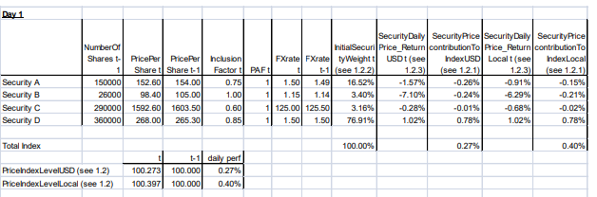
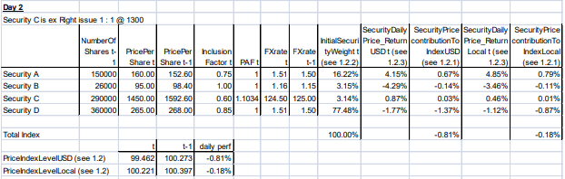
MSCI Price Index Methodology
INDEX MARKET CAPITALIZATION (Example)
Suppose C is going to have a right issue

Slide 13
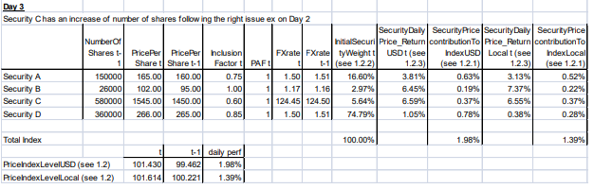
MSCI Price Index Methodology
INDEX MARKET CAPITALIZATION (Example)

Slide 14
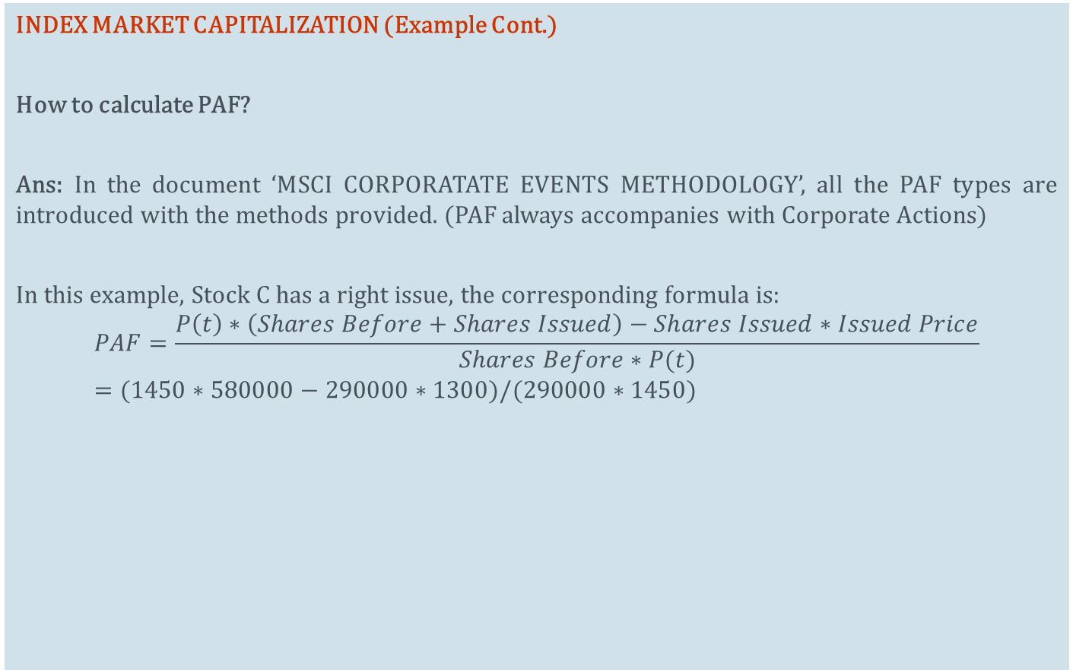
MSCI Price Index Methodology
INDEX MARKET CAPITALIZATION (Example Cont.)
How to calculate PAF?
Ans: In the document ‘MSCI CORPORATATE EVENTS METHODOLOGY’, all the PAF types are introduced with the methods provided. (PAF always accompanies with Corporate Actions)
In this example, Stock C has a right issue, the corresponding formula is:
$$PAF=\frac{P\left(t\right)∗\left(Shares Before+Shares Issued\right)−Shares Issued∗Issued Price}{Shares Before∗P(t)}=(1450∗580000−290000∗1300)/(290000∗1450)$$

Slide 15
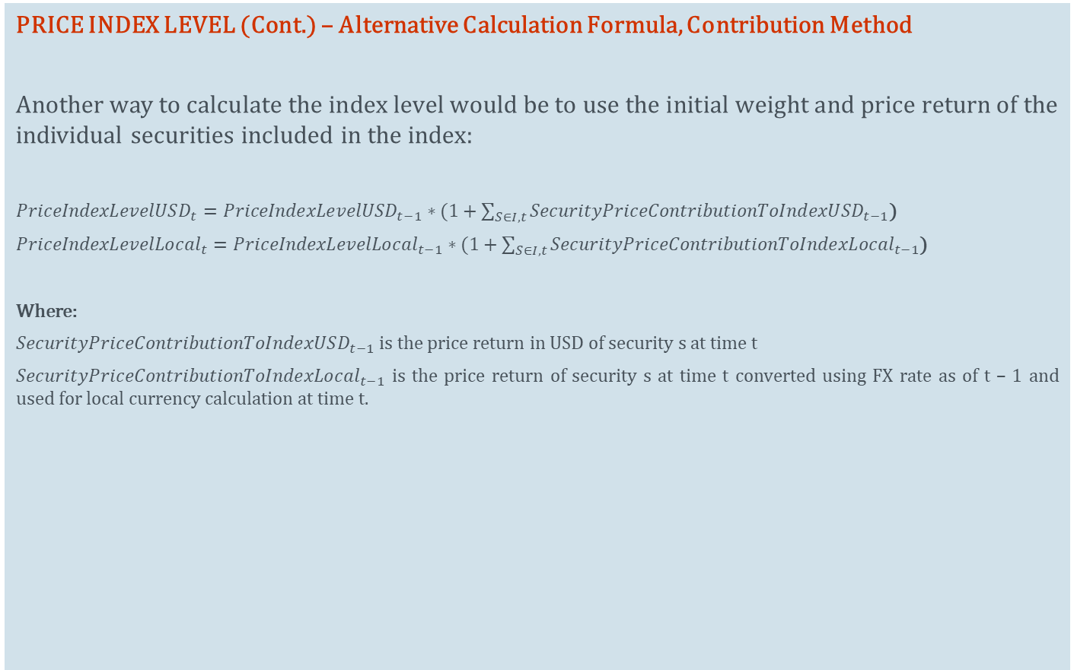
MSCI Price Index Methodology
PRICE INDEX LEVEL (Cont.) – Alternative Calculation Formula, Contribution Method
Another way to calculate the index level would be to use the initial weight and price return of the individual securities included in the index:
${PriceIndexLevelUSD}_{t}={PriceIndexLevelUSD}_{t−1}∗(1+\sum_{S∈I, t}{{SecurityPriceContributionToIndexUSD}_{t−1}}$)
${PriceIndexLevelLocal}_{t}={PriceIndexLevelLocal}_{t−1}∗(1+\sum_{S∈I, t}{{SecurityPriceContributionToIndexLocal}_{t−1}}$)
Where:
${SecurityPriceContributionToIndexUSD}_{t−1}$ is the price return in USD of security s at time t
${SecurityPriceContributionToIndexLocal}_{t−1}$ is the price return of security s at time t converted using FX rate as of t – 1 and used for local currency calculation at time t.

Slide 16
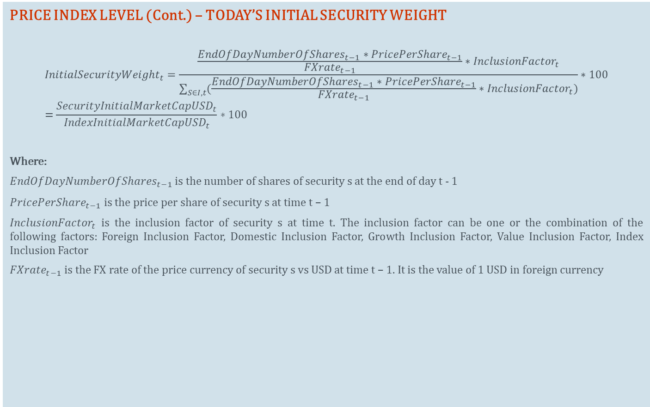
MSCI Price Index Methodology
PRICE INDEX LEVEL (Cont.) – TODAY’S INITIAL SECURITY WEIGHT
$${InitialSecurityWeight}_{t}=\frac{\frac{{EndOfDayNumberOfShares}_{t−1}∗{PricePerShare}_{t−1}}{{FXrate}_{t−1}}∗{InclusionFactor}_{t}}{\sum_{S∈I, t}{(\frac{{EndOfDayNumberOfShares}_{t−1}∗{PricePerShare}_{t−1}}{{FXrate}_{t−1}}∗{InclusionFactor}_{t})}}∗100=\frac{{SecurityInitialMarketCapUSD}_{t}}{{IndexInitialMarketCapUSD}_{t}}∗100$$
Where:
${EndOfDayNumberOfShares}_{t−1}$ is the number of shares of security s at the end of day t - 1
${PricePerShare}_{t−1}$ is the price per share of security s at time t – 1
${InclusionFactor}_{t}$ is the inclusion factor of security s at time t. The inclusion factor can be one or the combination of the following factors: Foreign Inclusion Factor, Domestic Inclusion Factor, Growth Inclusion Factor, Value Inclusion Factor, Index Inclusion Factor
${FXrate}_{t−1}$ is the FX rate of the price currency of security s vs USD at time t – 1. It is the value of 1 USD in foreign currency

Slide 17
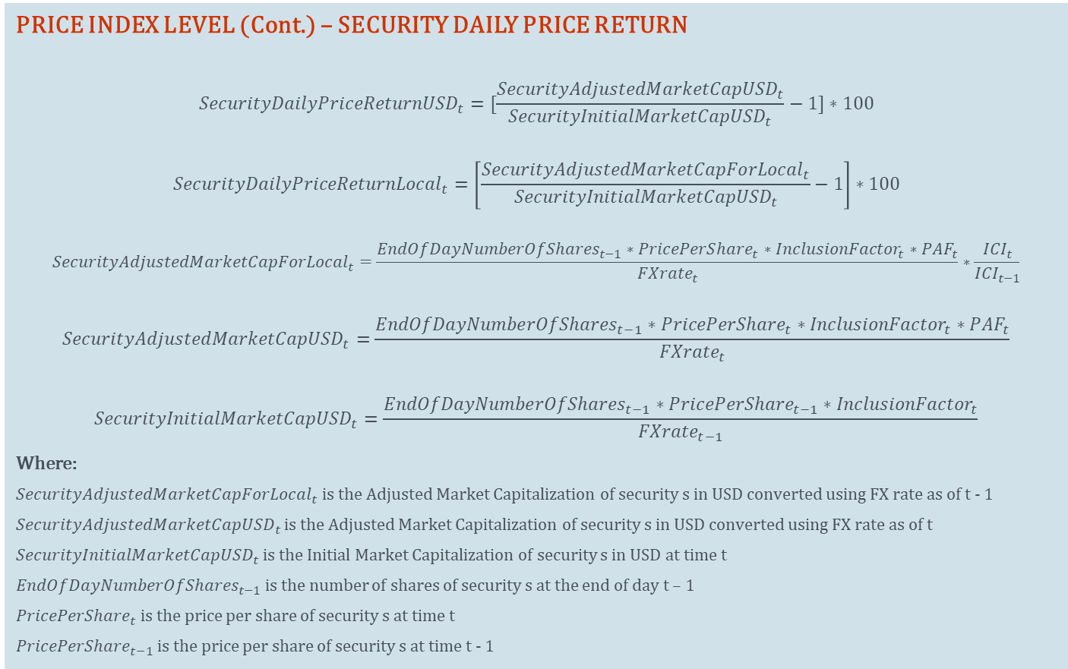
MSCI Price Index Methodology
PRICE INDEX LEVEL (Cont.) – SECURITY DAILY PRICE RETURN
$${SecurityDailyPriceReturnUSD}_{t}=[\frac{{SecurityAdjustedMarketCapUSD}_{t}}{{SecurityInitialMarketCapUSD}_{t}}−1]∗100$$
$${SecurityDailyPriceReturnLocal}_{t}=\left[\frac{{SecurityAdjustedMarketCapForLocal}_{t}}{{SecurityInitialMarketCapUSD}_{t}}−1\right]∗100$$
$${SecurityAdjustedMarketCapForLocal}_{t}=\frac{{EndOfDayNumberOfShares}_{t−1}∗{PricePerShare}_{t}∗{InclusionFactor}_{t}∗{PAF}_{t}}{{FXrate}_{t}}∗\frac{{ICI}_{t}}{{ICI}_{t−1}}$$
$${SecurityAdjustedMarketCapUSD}_{t}=\frac{{EndOfDayNumberOfShares}_{t−1}∗{PricePerShare}_{t}∗{InclusionFactor}_{t}∗{PAF}_{t}}{{FXrate}_{t}}$$
$${SecurityInitialMarketCapUSD}_{t}=\frac{{EndOfDayNumberOfShares}_{t−1}∗{PricePerShare}_{t−1}∗{InclusionFactor}_{t}}{{FXrate}_{t−1}}$$
Where:
${SecurityAdjustedMarketCapForLocal}_{t}$ is the Adjusted Market Capitalization of security s in USD converted using FX rate as of t - 1
${SecurityAdjustedMarketCapUSD}_{t}$ is the Adjusted Market Capitalization of security s in USD converted using FX rate as of t
${SecurityInitialMarketCapUSD}_{t}$ is the Initial Market Capitalization of security s in USD at time t
${EndOfDayNumberOfShares}_{t−1}$ is the number of shares of security s at the end of day t – 1
${PricePerShare}_{t}$ is the price per share of security s at time t
${PricePerShare}_{t−1}$ is the price per share of security s at time t - 1

Slide 18
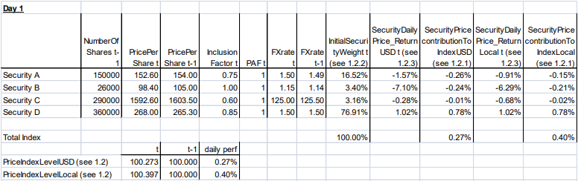
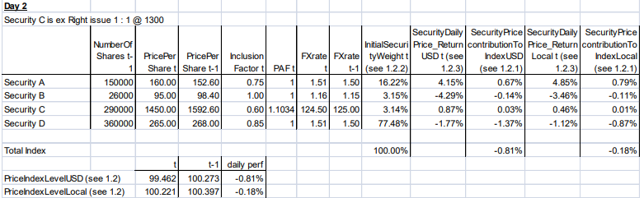
MSCI Price Index Methodology
PRICE INDEX LEVEL (Cont.) – SECURITY DAILY PRICE RETURN (Example)
Example of Calculation Using Contribution

Slide 19
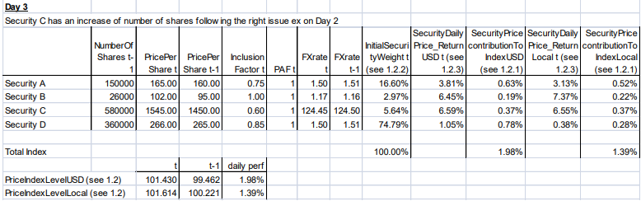
MSCI Price Index Methodology
PRICE INDEX LEVEL (Cont.) – SECURITY DAILY PRICE RETURN (Example)
Example of Calculation Using Contribution

Slide 20
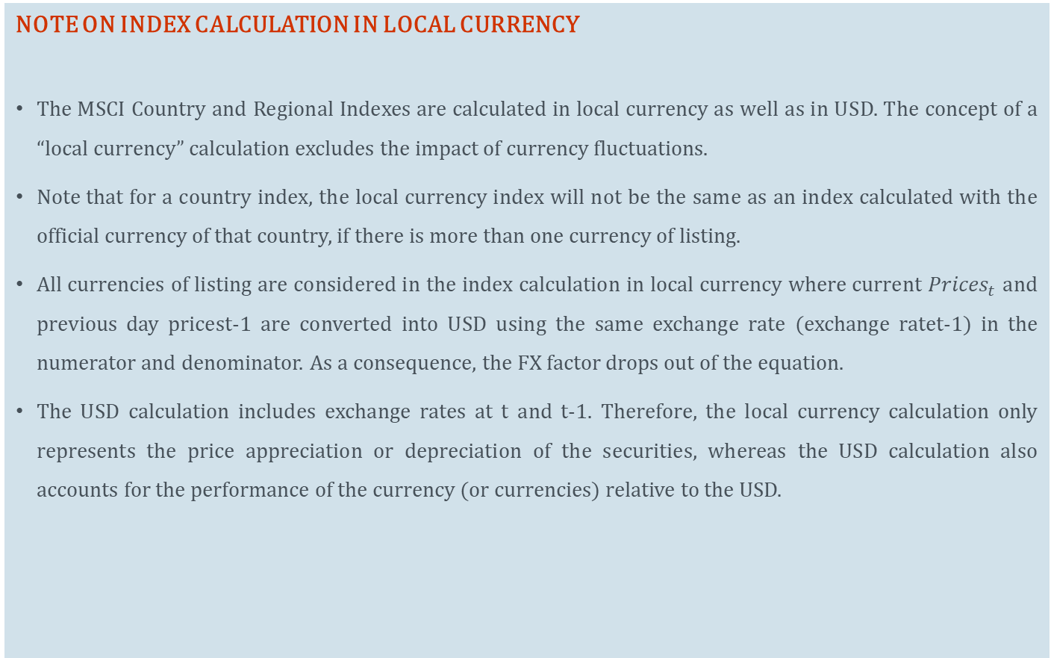
MSCI Price Index Methodology
NOTE ON INDEX CALCULATION IN LOCAL CURRENCY
The MSCI Country and Regional Indexes are calculated in local currency as well as in USD. The concept of a “local currency” calculation excludes the impact of currency fluctuations.
Note that for a country index, the local currency index will not be the same as an index calculated with the official currency of that country, if there is more than one currency of listing.
All currencies of listing are considered in the index calculation in local currency where current ${Prices}_{t}$ and previous day pricest-1 are converted into USD using the same exchange rate (exchange ratet-1) in the numerator and denominator. As a consequence, the FX factor drops out of the equation.
The USD calculation includes exchange rates at t and t-1. Therefore, the local currency calculation only represents the price appreciation or depreciation of the securities, whereas the USD calculation also accounts for the performance of the currency (or currencies) relative to the USD.

Slide 21
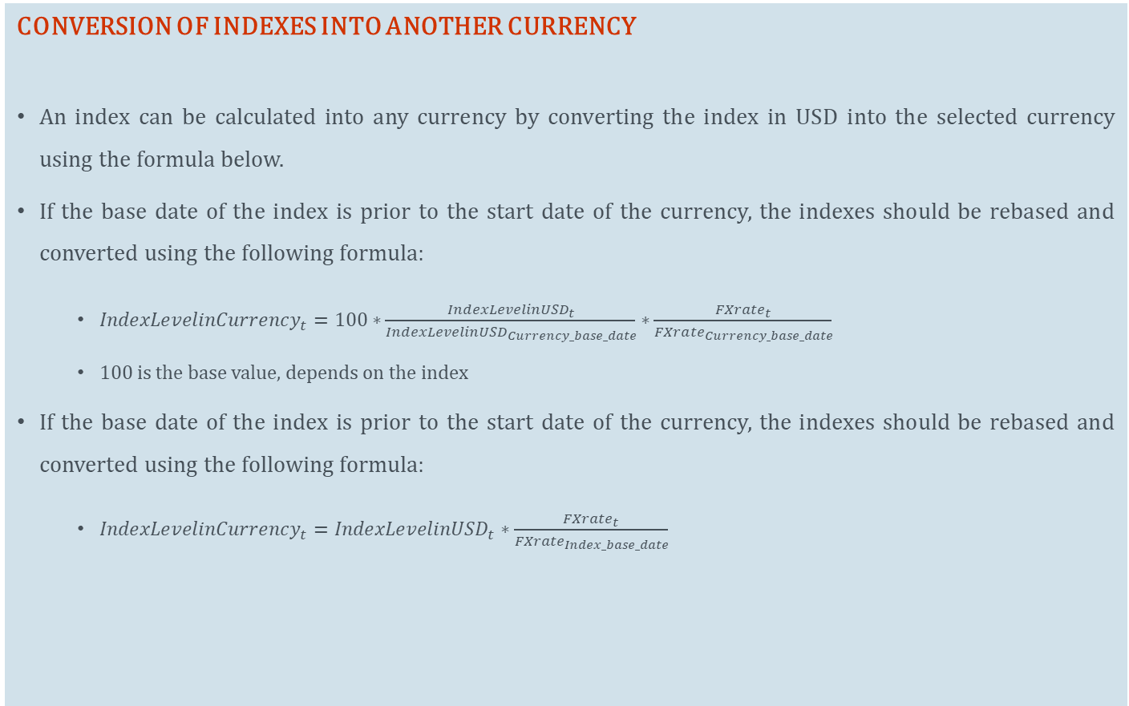
MSCI Price Index Methodology
CONVERSION OF INDEXES INTO ANOTHER CURRENCY
An index can be calculated into any currency by converting the index in USD into the selected currency using the formula below.
If the base date of the index is prior to the start date of the currency, the indexes should be rebased and converted using the following formula:
${IndexLevelinCurrency}_{t}=100∗\frac{{IndexLevelinUSD}_{t}}{{IndexLevelinUSD}_{Currency_base_date}}∗\frac{{FXrate}_{t}}{{FXrate}_{Currency_base_date}}$
100 is the base value, depends on the index
If the base date of the index is prior to the start date of the currency, the indexes should be rebased and converted using the following formula:
${IndexLevelinCurrency}_{t}={IndexLevelinUSD}_{t}∗\frac{{FXrate}_{t}}{{FXrate}_{Index_base_date}}$

Slide 22
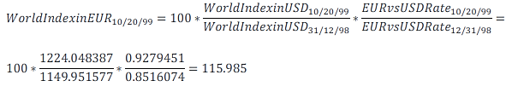
MSCI Price Index Methodology
CONVERSION OF INDEXES INTO ANOTHER CURRENCY (Example)
Example:
Calculation of the ‘The World Index’ in EUR as of October 20, 1999:
Note that the start date of EUR is 31-Dec-1998
The World Index in USD as of 31-Dec-98 = 1,149.951577
The World Index as of 20- Oct- 99 = 1,224.048387
FXrate EUR vs USD as of 31-Dec- 98 = 0.8516074
FXrate EUR vs USD as of 20-Oct-99 = 0.9279451

Slide 23
MSCI Price Index Methodology
MSCI Daily Total Return (DTR) Index Methodology
Total Return Indexes measure the market performance, including price performance and income from regular cash distributions (cash dividend payments or capital repayments). Regular cash distributions paid out of share capital or capital contribution reserves are treated in the same manner as regular cash dividends paid out of retained earnings. This income is reinvested in the index and thus makes up part of the total index performance.
MSCI’s Daily Total Return (DTR) methodology reinvests regular cash distributions in indexes on the ex-date of such distributions. Regular cash distributions are not considered in price indexes, except for special dividends and capital repayments deemed extraordinary in certain circumstances described below.
The standard Daily Total Return (DTR) Indexes are calculated and distributed on a daily basis. The indexes are available in USD and local currency (no currency impact), with gross and net total return.

Slide 24
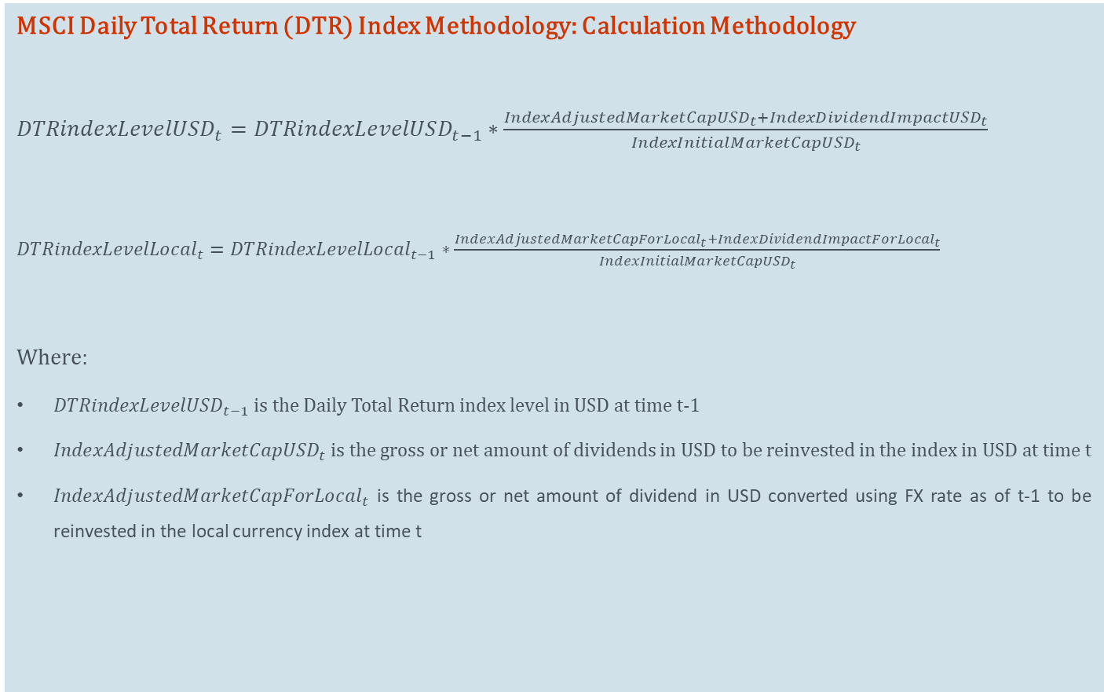
MSCI Price Index Methodology
MSCI Daily Total Return (DTR) Index Methodology: Calculation Methodology
${DTRindexLevelUSD}_{t}={DTRindexLevelUSD}_{t−1}∗\frac{{IndexAdjustedMarketCapUSD}_{t}+{IndexDividendImpactUSD}_{t}}{{IndexInitialMarketCapUSD}_{t}}$
${DTRindexLevelLocal}_{t}={DTRindexLevelLocal}_{t−1}∗\frac{{IndexAdjustedMarketCapForLocal}_{t}+{IndexDividendImpactForLocal}_{t}}{{IndexInitialMarketCapUSD}_{t}}$
Where:
${DTRindexLevelUSD}_{t−1}$ is the Daily Total Return index level in USD at time t-1
${IndexAdjustedMarketCapUSD}_{t}$ is the gross or net amount of dividends in USD to be reinvested in the index in USD at time t
${IndexAdjustedMarketCapForLocal}_{t}$ is the gross or net amount of dividend in USD converted using FX rate as of t-1 to be reinvested in the local currency index at time t

Slide 25
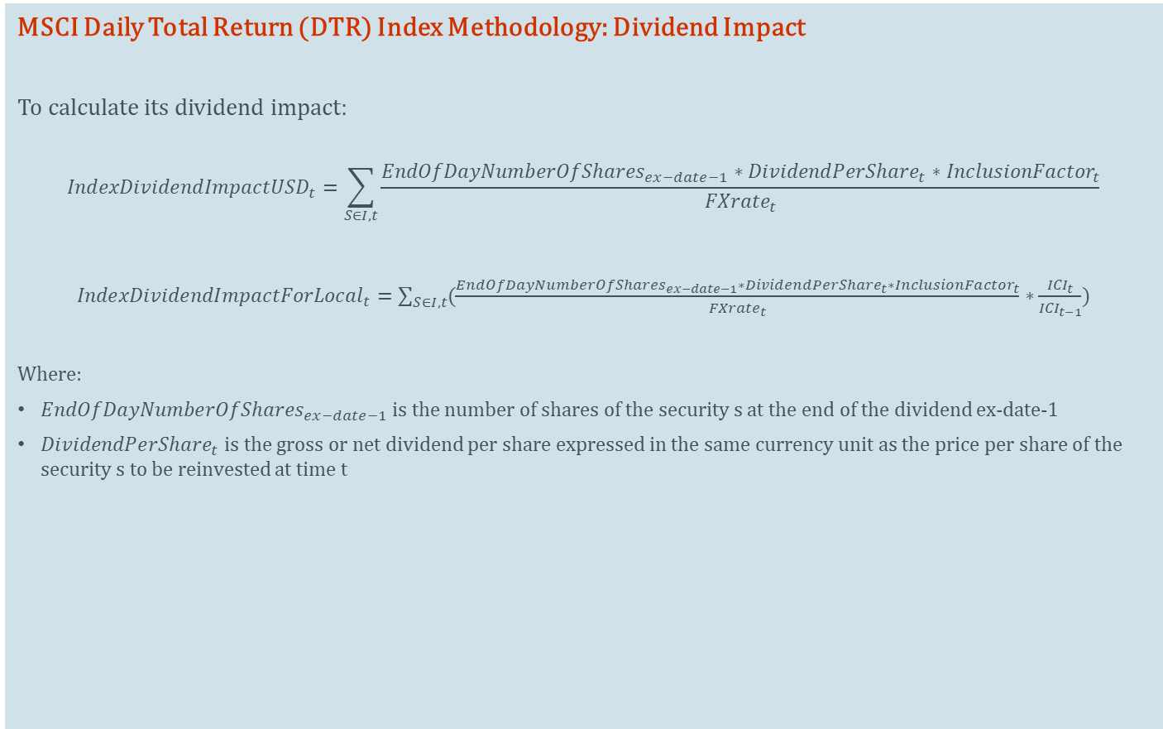
MSCI Price Index Methodology
MSCI Daily Total Return (DTR) Index Methodology: Dividend Impact
To calculate its dividend impact:
$${IndexDividendImpactUSD}_{t}=\sum_{S∈I, t}{\frac{{EndOfDayNumberOfShares}_{ex−date−1}∗{DividendPerShare}_{t}∗{InclusionFactor}_{t}}{{FXrate}_{t}}}$$
${IndexDividendImpactForLocal}_{t}=\sum_{S∈I, t}{(\frac{{EndOfDayNumberOfShares}_{ex−date−1}∗{DividendPerShare}_{t}∗{InclusionFactor}_{t}}{{FXrate}_{t}}}∗\frac{{ICI}_{t}}{{ICI}_{t−1}}$)
Where:
${EndOfDayNumberOfShares}_{ex−date−1}$ is the number of shares of the security s at the end of the dividend ex-date-1
${DividendPerShare}_{t}$ is the gross or net dividend per share expressed in the same currency unit as the price per share of the security s to be reinvested at time t

Slide 26
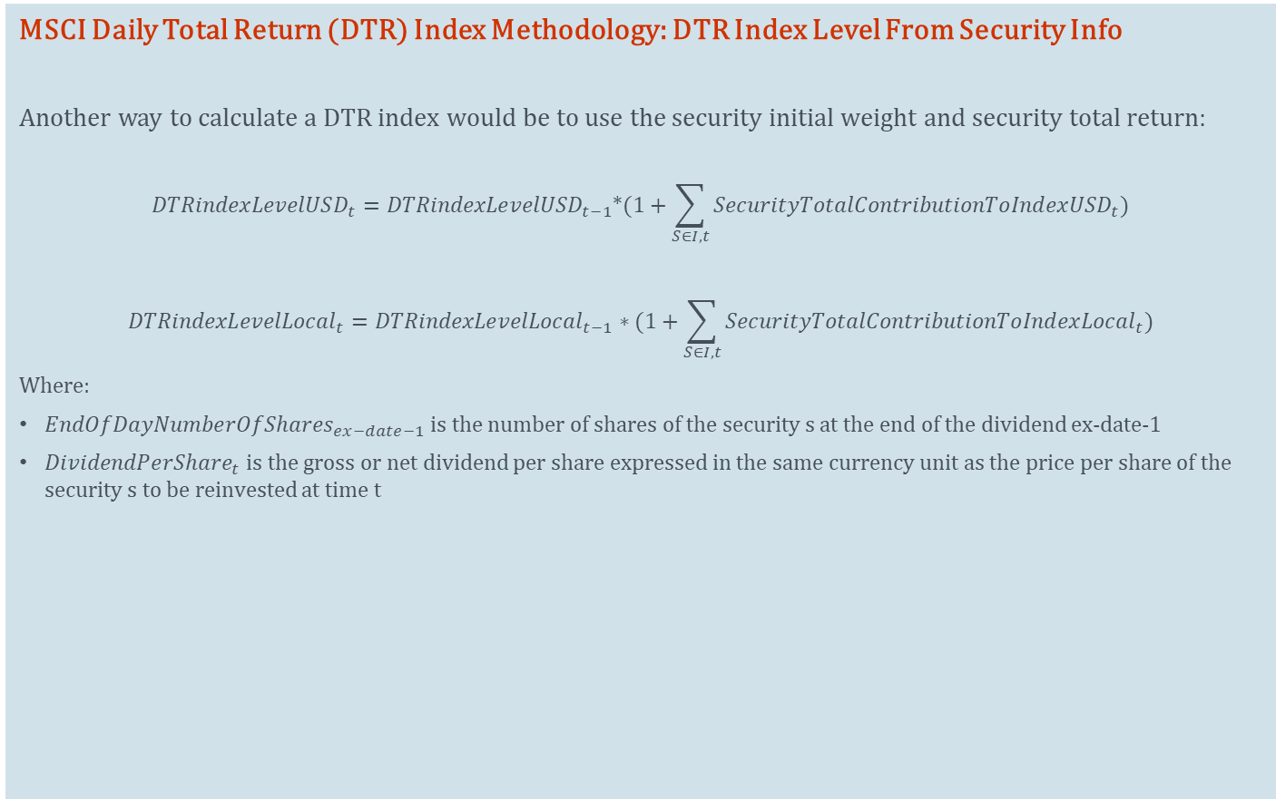
MSCI Price Index Methodology
MSCI Daily Total Return (DTR) Index Methodology: DTR Index Level From Security Info
Another way to calculate a DTR index would be to use the security initial weight and security total return:
$${DTRindexLevelUSD}_{t}={DTRindexLevelUSD}_{t−1}∗(1+\sum_{S∈I, t}{{SecurityTotalContributionToIndexUSD}_{t})}$$
$${DTRindexLevelLocal}_{t}={DTRindexLevelLocal}_{t−1}∗(1+\sum_{S∈I, t}{{SecurityTotalContributionToIndexLocal}_{t})}$$
Where:
${EndOfDayNumberOfShares}_{ex−date−1}$ is the number of shares of the security s at the end of the dividend ex-date-1
${DividendPerShare}_{t}$ is the gross or net dividend per share expressed in the same currency unit as the price per share of the security s to be reinvested at time t

Slide 27
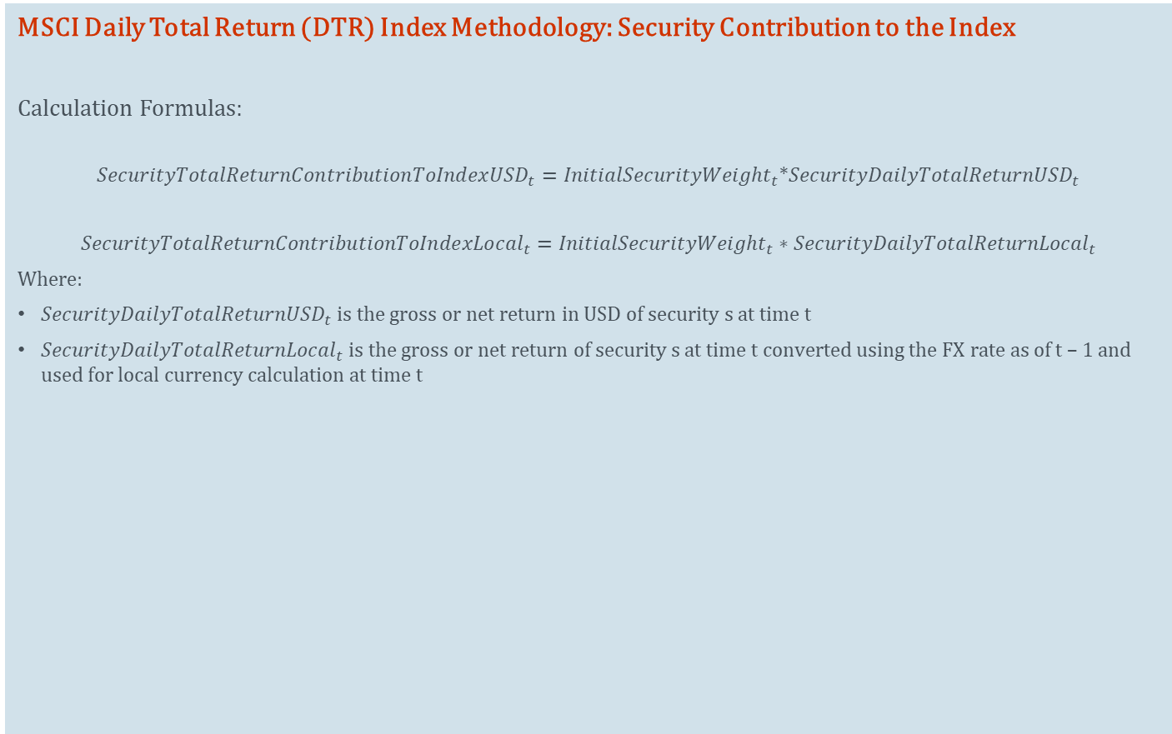
MSCI Price Index Methodology
MSCI Daily Total Return (DTR) Index Methodology: Security Contribution to the Index
Calculation Formulas:
$${SecurityTotalReturnContributionToIndexUSD}_{t}={InitialSecurityWeight}_{t}∗{SecurityDailyTotalReturnUSD}_{t}$$
$${SecurityTotalReturnContributionToIndexLocal}_{t}={InitialSecurityWeight}_{t}∗{SecurityDailyTotalReturnLocal}_{t}$$
Where:
${SecurityDailyTotalReturnUSD}_{t}$ is the gross or net return in USD of security s at time t
${SecurityDailyTotalReturnLocal}_{t}$ is the gross or net return of security s at time t converted using the FX rate as of t – 1 and used for local currency calculation at time t

Slide 28
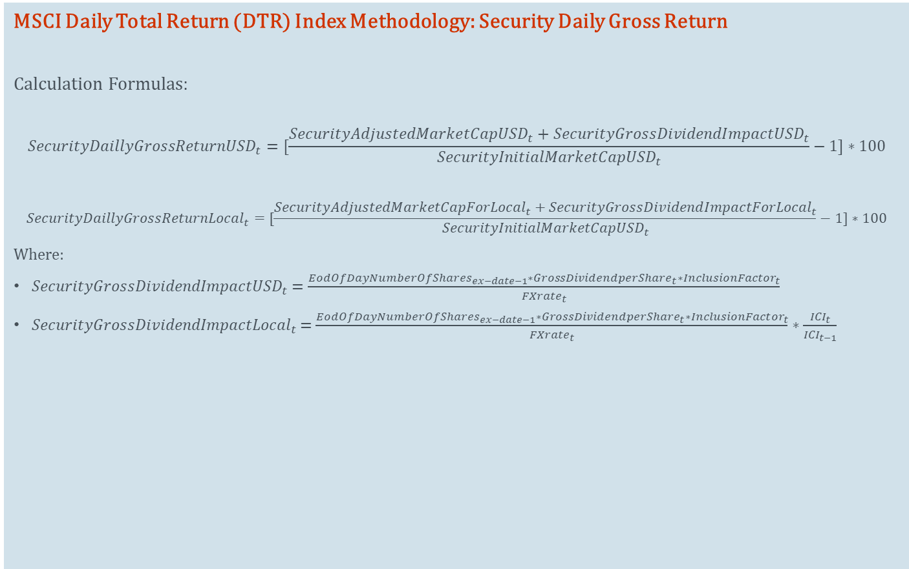
MSCI Price Index Methodology
MSCI Daily Total Return (DTR) Index Methodology: Security Daily Gross Return
Calculation Formulas:
$${SecurityDaillyGrossReturnUSD}_{t}=[\frac{{SecurityAdjustedMarketCapUSD}_{t}+{SecurityGrossDividendImpactUSD}_{t}}{{SecurityInitialMarketCapUSD}_{t}}−1]∗100$$
$${SecurityDaillyGrossReturnLocal}_{t}=[\frac{{SecurityAdjustedMarketCapForLocal}_{t}+{SecurityGrossDividendImpactForLocal}_{t}}{{SecurityInitialMarketCapUSD}_{t}}−1]∗100$$
Where:
${SecurityGrossDividendImpactUSD}_{t}$ $=\frac{{EodOfDayNumberOfShares}_{ex−date−1}∗{GrossDividendperShare}_{t}∗{InclusionFactor}_{t}}{{FXrate}_{t}}$
${SecurityGrossDividendImpactLocal}_{t}$ $=\frac{{EodOfDayNumberOfShares}_{ex−date−1}∗{GrossDividendperShare}_{t}∗{InclusionFactor}_{t}}{{FXrate}_{t}}∗\frac{{ICI}_{t}}{{ICI}_{t−1}}$

Slide 29

MSCI Price Index Methodology
MSCI Daily Total Return (DTR) Index Methodology: Security Daily Net Return
Calculation Formulas:
$${SecurityDaillyNetReturnUSD}_{t}=[\frac{{SecurityAdjustedMarketCapUSD}_{t}+{SecurityNetDividendImpactUSD}_{t}}{{SecurityInitialMarketCapUSD}_{t}}−1]∗100$$
$${SecurityDaillyNetReturnLocal}_{t}=[\frac{{SecurityAdjustedMarketCapForLocal}_{t}+{SecurityNetDividendImpactForLocal}_{t}}{{SecurityInitialMarketCapUSD}_{t}}−1]∗100$$
Where:
${SecurityNetDividendImpactUSD}_{t}$ $=\frac{{EodOfDayNumberOfShares}_{ex−date−1}∗{NetDividendperShare}_{t}∗{InclusionFactor}_{t}}{{FXrate}_{t}}$
${SecurityNetDividendImpactLocal}_{t}$ $=\frac{{EodOfDayNumberOfShares}_{ex−date−1}∗{NetDividendperShare}_{t}∗{InclusionFactor}_{t}}{{FXrate}_{t}}∗\frac{{ICI}_{t}}{{ICI}_{t−1}}$

Slide 30
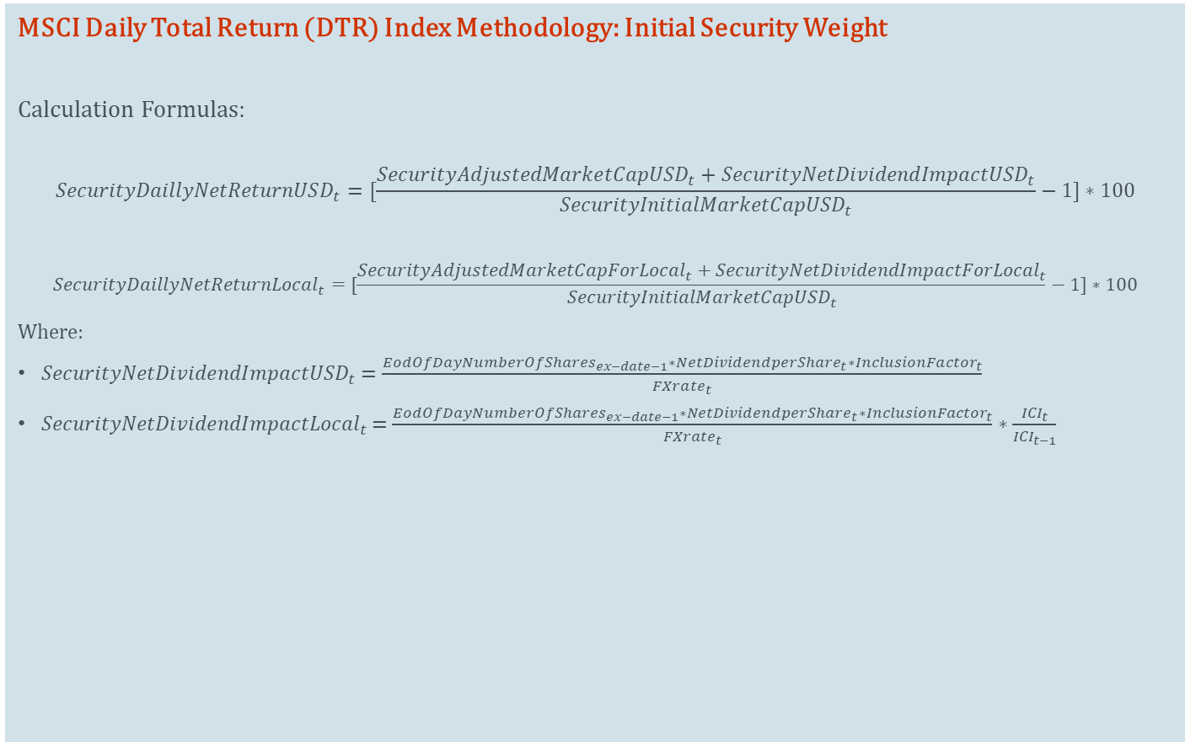
MSCI Price Index Methodology
MSCI Daily Total Return (DTR) Index Methodology: Initial Security Weight
Calculation Formulas:
$${SecurityDaillyNetReturnUSD}_{t}=[\frac{{SecurityAdjustedMarketCapUSD}_{t}+{SecurityNetDividendImpactUSD}_{t}}{{SecurityInitialMarketCapUSD}_{t}}−1]∗100$$
$${SecurityDaillyNetReturnLocal}_{t}=[\frac{{SecurityAdjustedMarketCapForLocal}_{t}+{SecurityNetDividendImpactForLocal}_{t}}{{SecurityInitialMarketCapUSD}_{t}}−1]∗100$$
Where:
${SecurityNetDividendImpactUSD}_{t}$ $=\frac{{EodOfDayNumberOfShares}_{ex−date−1}∗{NetDividendperShare}_{t}∗{InclusionFactor}_{t}}{{FXrate}_{t}}$
${SecurityNetDividendImpactLocal}_{t}$ $=\frac{{EodOfDayNumberOfShares}_{ex−date−1}∗{NetDividendperShare}_{t}∗{InclusionFactor}_{t}}{{FXrate}_{t}}∗\frac{{ICI}_{t}}{{ICI}_{t−1}}$

Slide 31
appendix
31

Slide 32
About MSCI
For more than 40 years, MSCI’s research-based indexes and analytics have helped the world’s leading investors build and manage better portfolios. Clients rely on our offerings for deeper insights into the drivers of performance and risk in their portfolios, broad asset class coverage and innovative research.
Our line of products and services includes indexes, analytical models, data, real estate benchmarks and ESG research.
MSCI serves 99 of the top 100 largest money managers, according to the most recent P&I ranking.
For more information, visit us at www.msci.com.

